Slide 1

Text similarity
Nalani Schumacher

Slide 2
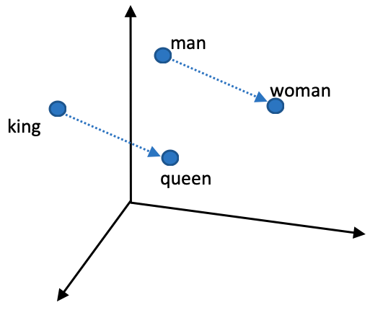
Background
Text similarity
Words
Phrases

Slide 3
Use Cases

Slide 4
DEMO

Slide 5
Design

Slide 6
Project Structure

Slide 7
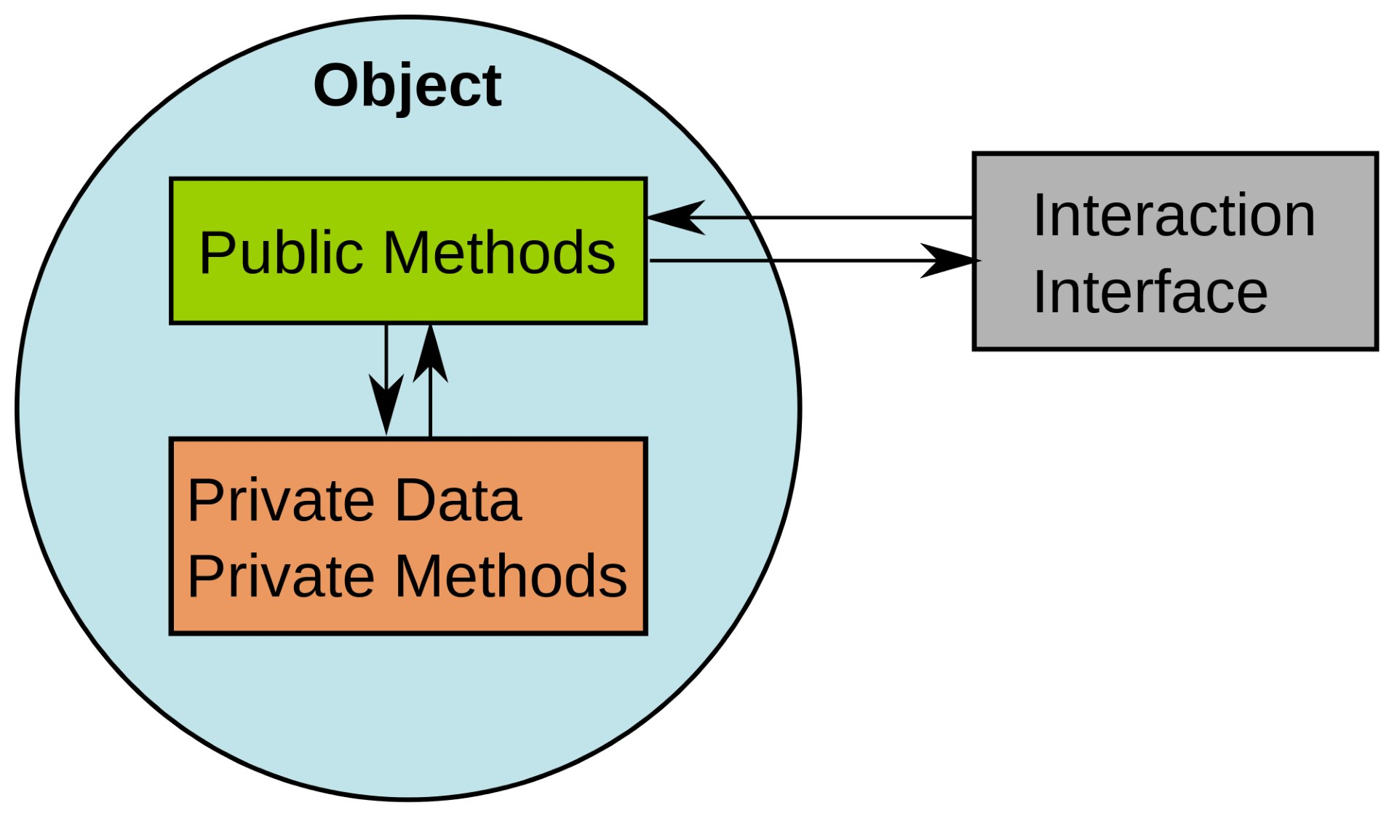
Lessons Learned
Tools
Travis-CI
Different python versions
Run all tests & generate coverage report
Unittest
Set up / tear down methods
Design
Verb or action prefix on methods for clarity: “calculate”, “get”, “tokenize”, “rank”
Easier to understand, clearer expectations
Separating functionality: modules, classes, methods
Easily extendable and modifiable
Abstraction, information hiding
Easier to use

Slide 8

Future Work
In the package:
Cross-modality expansion such as with text to image similarity
In the clean text module and text models module:
Add support for other languages besides English
In text models module:
Add more natural language models
In the rankers module:
Add other rankers

